Slide 1
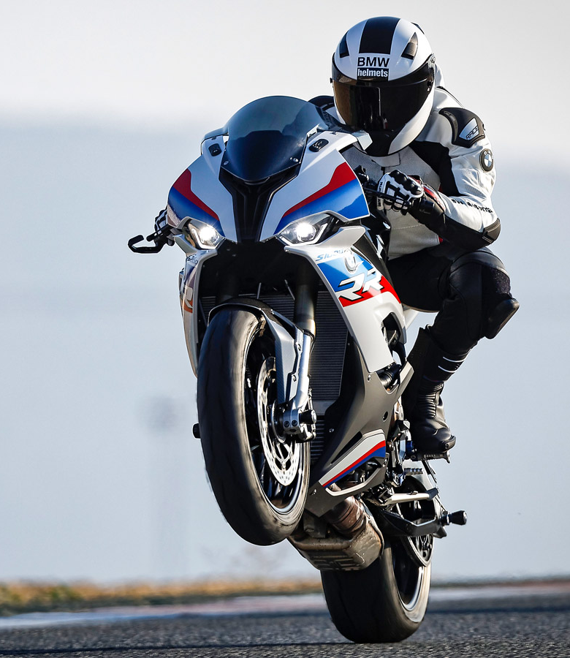
WE ALL KEEP DREAMING
01.
GRAPHIC DESIGN
A wonderful serenity has taken possession of my entire soul, like these sweet mornings of spring which I enjoy with my whole heart.
A wonderful serenity has taken possession of my entire soul, like these sweet mornings of spring which I enjoy with my whole heart. A wonderful serenity has taken possession of my entire soul, like these sweet mornings of spring which I enjoy with my whole heart.
A wonderful serenity has taken possession of my entire soul, like these sweet mornings of spring which I enjoy with my whole heart.
.
tsunami

Slide 2
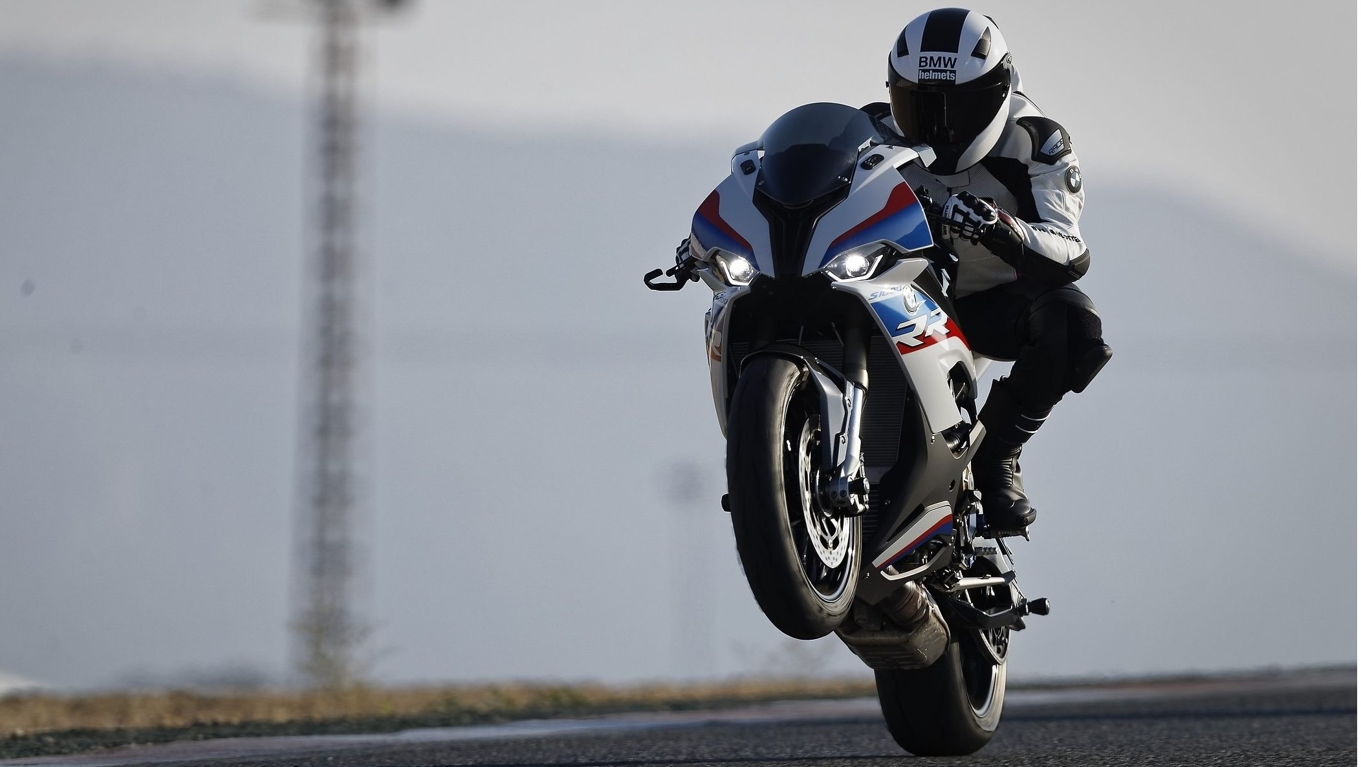

Slide 3





ABOUT US
MANAGEMENT COURSES
We are on of the best institure that is available in the country for management courses. With strength of 15000 students, we take proud in our faculty, courses, college premises and placement records

Slide 4

TOPIC 1
TOPIC 2
TOPIC 3
TOPIC 4

Slide 5
TOPIC 1

Slide 6
TOPIC 1
Text 1
Text 1
Text 1
Text 1

Slide 7
TOPIC 1
TOPIC 2
TOPIC 3
TOPIC 4

Slide 8
TOPIC 1

Slide 9
TOPIC 1
Text 1
Text 2
Text 4
Text 3

